Slide 1
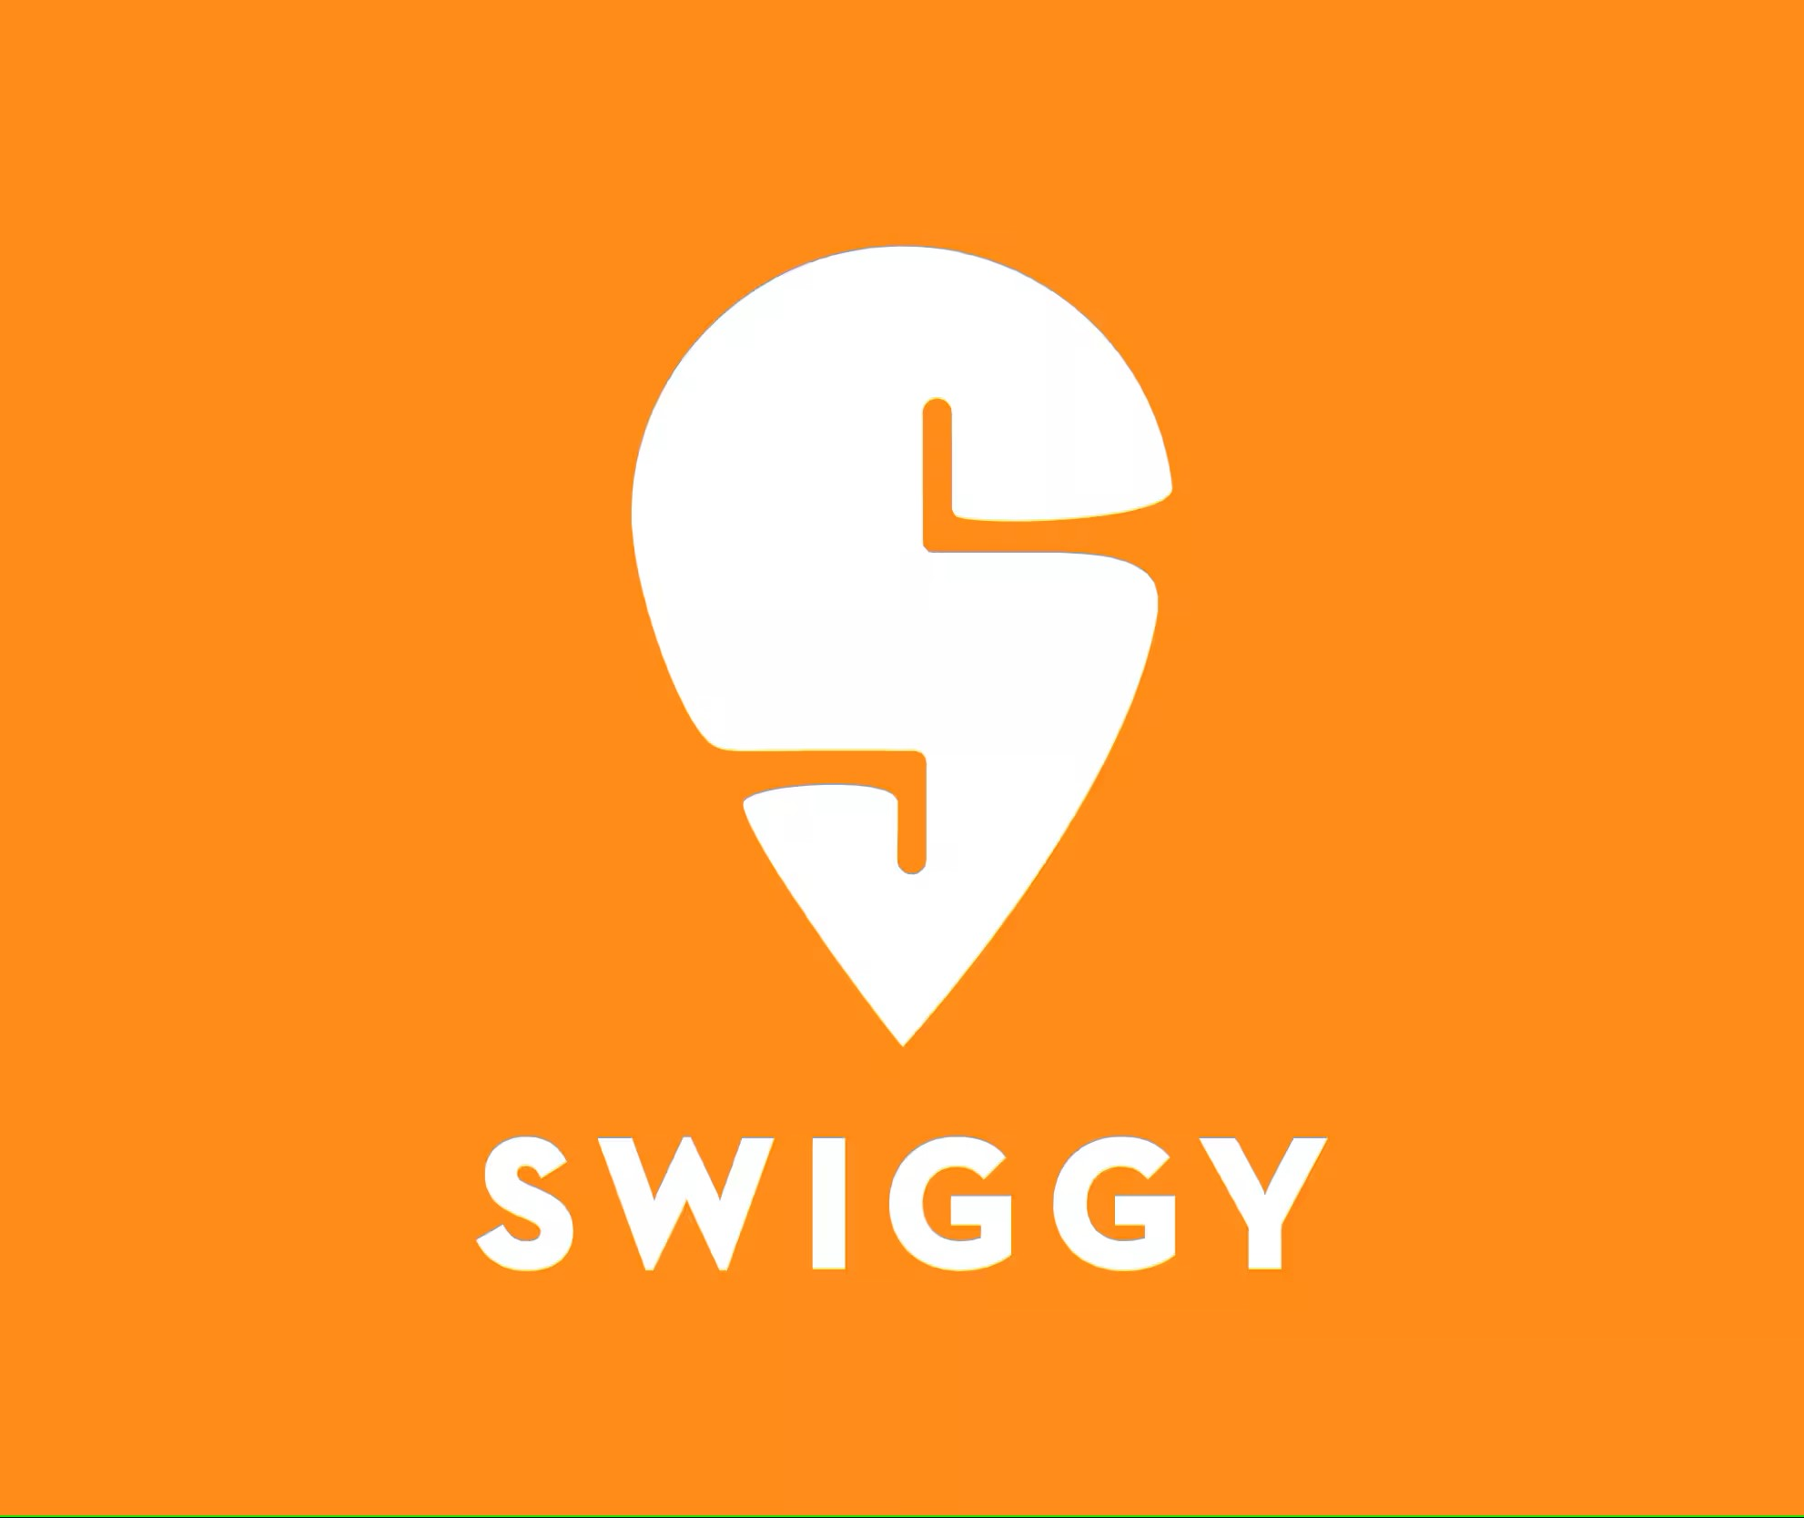
Swiggy Case Study
Implementing Data Integration, Cleansing, and Reporting for Swiggy's Restaurant Data
January 08, 2025
Surya Kiran P M
Data Engineer

Slide 2
Objective
Data Pipeline Construction Develop a robust data pipeline using Azure Data Factory for seamless data ingestion and integrate Databricks for transformation and analytics using PySpark and SparkSQL.
Data Storage & Processing Implement a NoSQL landing zone for raw data storage and create efficient SQL-based materialized views to optimize data processing and analysis.
Data Visualization Enable actionable insights through visualization by utilizing Databricks dashboards or Power BI (optional) to present data analysis results clearly and effectively.
Final Deliverable Achieve a fully functional and automated data pipeline that processes, transforms, and visualizes data, providing valuable business insights.

Slide 3
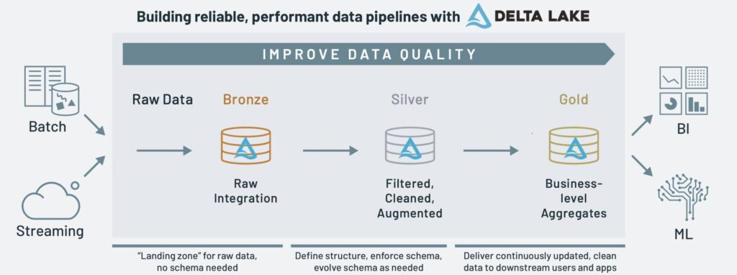
Approach Medallion Architecture
A medallion architecture is a data design pattern used to organize data logically. Its goal is to incrementally and progressively improve the structure and quality of data as it flows through each layer of the architecture (from Bronze ⇒ Silver ⇒ Gold layer tables). Medallion architectures are sometimes also referred to as multi-hop architectures.
Bronze layer : Ingests raw data from cloud storage, Kafka, and Salesforce. No data cleanup or validation is performed here.
Silver layer : Data cleanup and validation are performed in this layer.
Gold layer : This layer is designed for business users. It contains fewer datasets than silver and gold.

Slide 4
Approach
Data Ingestion
Azure Data Factory (ADF):
Used to automate data ingestion from the source (e.g., CSV files) into the Bronze Layer in Azure Data Lake Storage.
Provides scheduling, monitoring, and orchestration of the data ingestion process
Data Storage
Azure Data Lake Storage (ADLS):
Bronze Layer: Stores raw, unprocessed data.
Silver Layer: Stores cleaned, deduplicated, and transformed data.
Gold Layer: Stores business-ready, aggregated data.
Benefits include hierarchical namespace support, scalability, and integration with Delta Lake.

Slide 5
Approach
Data Transformation
Azure Databricks:
The main service for data cleaning, enrichment, and transformation.
Uses PySpark or SQL for processing data at scale.
Integrates with Delta Lake to handle schema validation, deduplication, and lineage tracking.
Data Visualization
Databricks SQL:
A dedicated tool for querying the Gold Layer (Delta tables).
Enables building SQL-based dashboards and interactive visualizations directly within the Databricks workspace.
Supports visualization types such as bar charts, line graphs, and pie charts.

Slide 6
Approach
Orchestration and Workflow Management
Azure Data Factory (ADF) (optional):
Can orchestrate the entire pipeline, including data ingestion, triggering Databricks jobs, and monitoring data workflows.
Security and Logging
Used Azure Key Vault with Databricks Secret Scope for secure credential management.
Pipeline details (e.g., name, status, timestamps) logged into SQL audit tables via Stored Procedure.

Slide 7
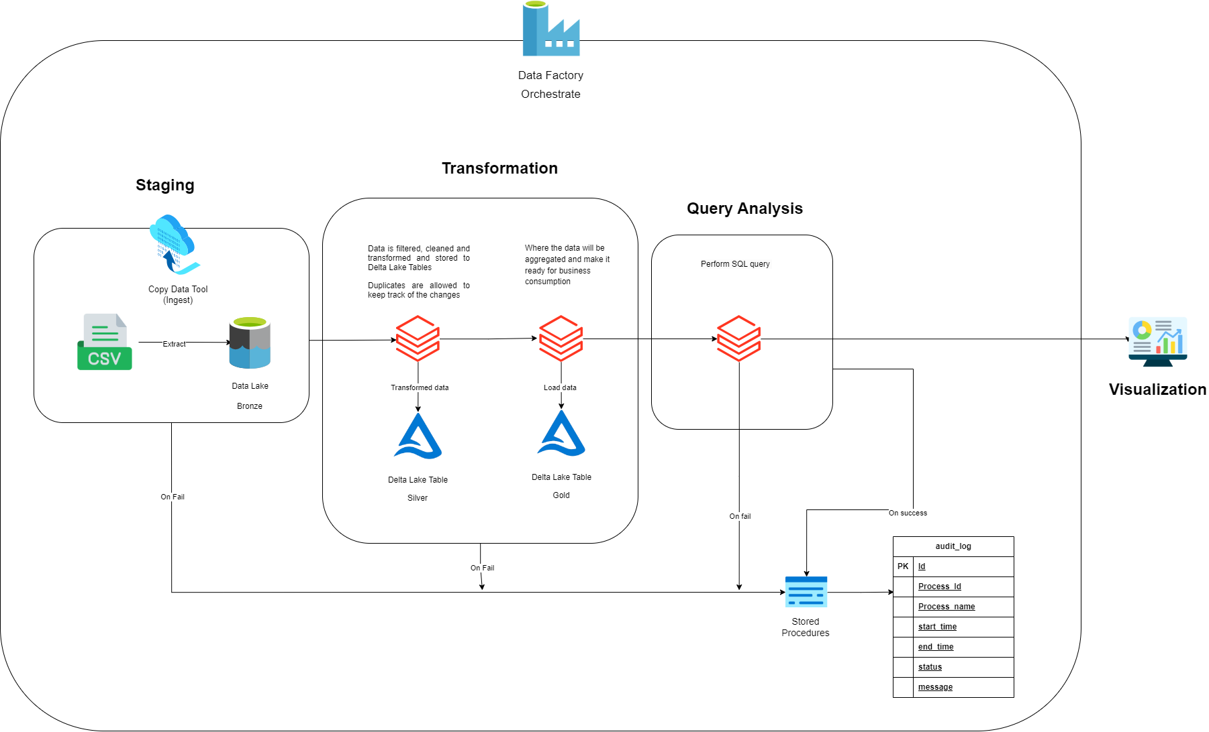
Architecture

Slide 8
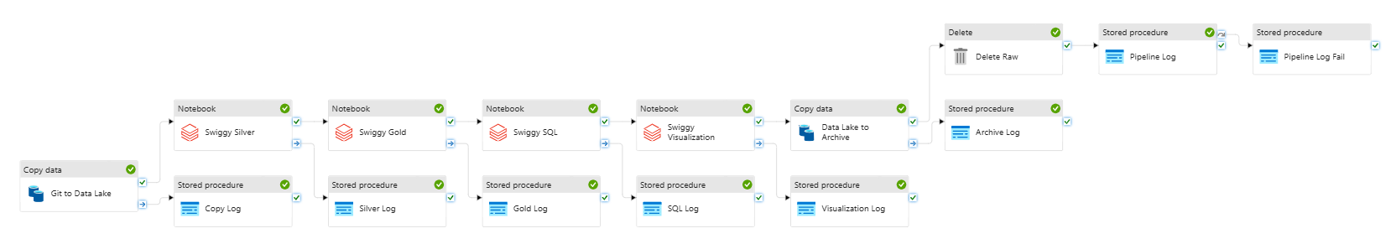
Output Pipeline Orchestration

Slide 9
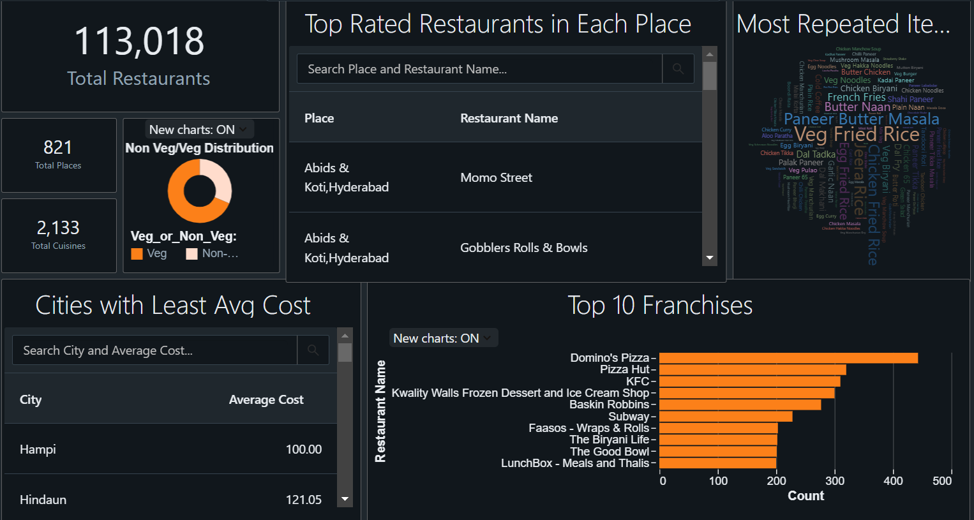
Output Data Visualisation

Slide 10
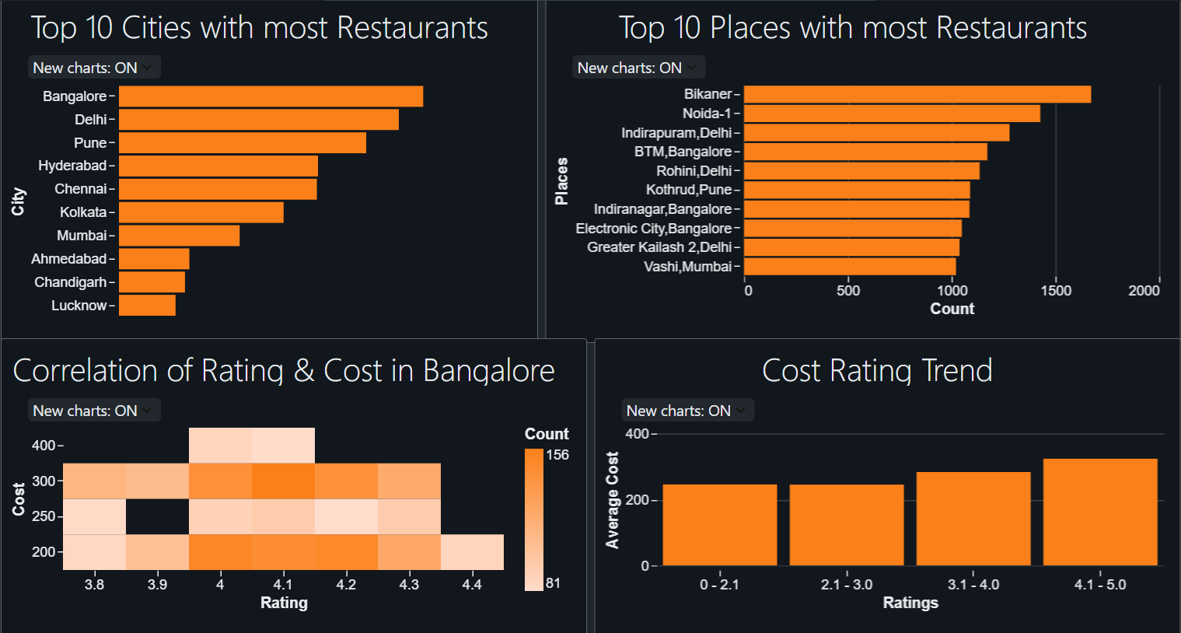
Output Data Visualisation

Slide 11
Challenges & Resolutions
Fetching Data from Nested JSON
Encountered difficulties understanding the data due to inconsistencies in the nested JSON structure.
However, we was able to resolve this by analyzing the schema and utilizing PySpark to efficiently break down and process the JSON data.
Managing Credentials Securely
To ensure the secure storage of credentials by avoiding exposure in the pipeline or notebooks.
Utilized Azure Key Vault for secure credential management and integrated it with Databricks Secret Scope to enable seamless and protected access.
Data Logging
Identifying an effective method to implement data logging for monitoring pipeline activity.
Explored approach, used Stored Procedure to log details directly into a SQL audit table.
Identifying Inconsistencies and Anomalies
Identifying anomalies and inconsistencies in raw data structures, such as unexpected formats, outliers, or incorrect mappings.
Implemented PySpark-based data profiling to detect irregularities and applied targeted transformations to standardize and correct issues.

Slide 12
Learnings
Used Azure Key Vault with Databricks Secret Scope for secure credential management.
Gained hands-on experience in implementing the Medallion Architecture, which leverages Bronze, Silver, and Gold layers for structured data management.
Gained experience in dealing with nested json data.
Footnotes/references, if needed, appear here in Arial Regular 8pt.
Text grows upwards as lines are added. Copy and paste this box onto other slides as needed.

